Slide 1


CS-446: Information Systems Security
Chapter # 7: Basic Key Exchange
Prof. Dr. Sufian Hameed
Department of Computer Science
FAST-NUCES

Slide 2
Now that we know how two users can protect data using a shared secret key, the next question is how did these two users share a generated secret key to begin
with?
This question will take us into the world of public key cryptography.
In this module, we will look at a few toy key exchange protocols as a way to introduce the main ideas of public key cryptography.
We will see key exchange and design secure key exchange protocols after we build a few more public key tools.
So imagine for a second that there a N users in the world. And the question is, how do these users manage these secret keys that they're gonna use
to communicate with one another

Slide 3
Overview
What will you learn today
Basic Key Exchange
Trusted 3rd party (introduce toy protocol)
Merkle Puzzle
The Diffie-Helmann Protocol
Public Key Encryption

Slide 4
Trusted 3rd Parties

Slide 5
Key management
Problem: n users. Storing mutual secret keys is difficult
Total: O(n) keys per user

Slide 6
A better solution
Online Trusted 3rd Party (TTP)
TTP
Notes:
Users u1, …, un. And alice and bob. They have shared keys Ka, Kb. Every user only remembers one key.

Slide 7
Generating keys: a toy protocol
Alice wants a shared key with Bob. Eavesdropping security only.
Bob (k_{B}) Alice (k_{A}) TTP
“Alice wants key with Bob”
choose random k_{AB}
ticket
k_{AB}
k_{AB}
(E,D) a CPA-secure cipher

Slide 8
Generating keys: a toy protocol
Alice wants a shared key with Bob. Eavesdropping security only.
Bob (k_{B}) Alice (k_{A}) TTP
“Alice wants key with Bob”
choose random k_{AB}
ticket
k_{AB}
k_{AB}
(E,D) a CPA-secure cipher
Notes:
Only Secure against Evesdropping. Not Secure against Tampering.
This means that TTP has access to Alice and Bob secret key

Slide 9
And the first question to ask is, Why is this protocol secure? Even if we only consider eavesdropping adversaries
So, at the moment all we care about is just
security against an eavesdropper, So let's think.
What does an eavesdropper see in
this protocol. Well basically he sees these two cipher texts. Right, he sees the
cipher text that's encrypted for Alice. And then he sees the ticket that's
encrypted for Bob. And in fact he might see many instances of these messages, in
particular if Alice and Bob continuously exchange keys in this way he's gonna see
many messages of this type and our goal is to say that he has no information about
the exchanged key KAB.
So this follows directly from the CPA security of the
cipher E D because the eavesdropper can't really distinguish between encryptions of
the secret key KAB from encryption of just random junk. That's the definition of CPA
security and as a result, he can't distinguish the key KAB from, you know,
random junk which means that he learns nothing about KAB.
This is kind of a very high level argument for why this is eavesdropping security but it's enough for our purposes here. So the bottom line is that in this protocol the eavesdropper would actually have no information about what KAB is. And therefore it's okay to use KAB as secret key to exchange messages between Alice and Bob.

Slide 10
Generating keys: a toy protocol
Alice wants a shared key with Bob. Eavesdropping security only.
Eavesdropper sees: E(k_{A},“A, B” ll k_{AB}); E(k_{B},“A, B” ll k_{AB} )
(E,D) is CPA-secure ⇒ eavesdropper learns nothing about k_{AB}
Note: TTP needed for every key exchange, knows all session keys.
(basis of Kerberos system)

Slide 11
Toy protocol: insecure against active attacks
Example: insecure against replay attacks
Attacker records session between Alice and merchant Bob
For example a book order
Attacker replays session to Bob
Bob thinks Alice is ordering another copy of book

Slide 12
Key question
Can we generate shared keys without an online trusted 3rd party?
Answer: yes!
Starting point of public-key cryptography:
Merkle (1974), Diffie-Hellman (1976), RSA (1977)
More recently: ID-based enc. (BF 2001), Functional enc. (BSW 2011)

Slide 13
Key exchange without an online TTP?
Goal: Alice and Bob want shared key, unknown to eavesdropper
For now: security against eavesdropping only (no tampering)
Alice
Bob
eavesdropper ??
Can this be done using generic symmetric crypto?

Slide 14
Merkle Puzzles
In cryptography, Merkle's puzzles is an early construction for a public-key cryptosystem, a protocol devised by Ralph Merkle in 1974 and published in 1978.
It allows two parties to agree on a shared secret by exchanging messages, even if they have no secrets in common beforehand.

Slide 15
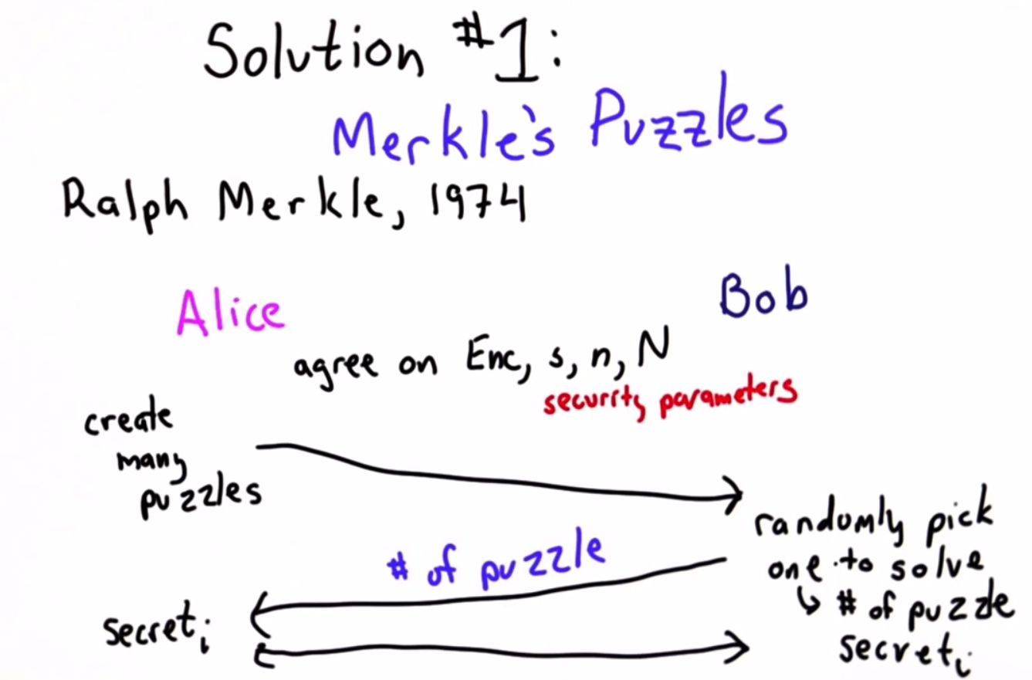

Slide 16
Abstract Description How DH works:
Suppose Alice and Bob wish to communicate.
Bob can send a message to Alice as follows:
first he creates a large number of puzzles, each of a moderate amount of difficulty — it must be possible for Alice to solve the puzzle with a moderate amount of computing effort.
The puzzles are in the form of an encrypted message with an unknown key; the key must be short enough to allow a brute force attack.
Bob sends all of the puzzles (i.e. encrypted messages) to Alice, who chooses one randomly, and solves it.
The decrypted solution contains an identifier as well as a session key, so Alice can communicate back to Bob which puzzle she has solved.
Both parties now have a common key; Alice, because she solved a puzzle, and Bob, because he sent the puzzle.

Slide 17
Any eavesdropper (Eve, say) has a harder task — she does not know which puzzle was solved by Alice. Her best strategy is to solve all the puzzles, but since there are so many, this is more computationally expensive for Eve than it is for Alice.

Slide 18
High Level Description
1. Bob generates 2^{N} messages containing, "This is message X. This is the symmetrical key Y", where X is a randomly generated identifier, and Y is a randomly generated secret key meant for symmetrical encryption.
Hence, both X and Y are unique to each message.
All the messages are encrypted in a way such that a user may conduct a brute force attack on each message with some difficulty.
Bob sends all the encrypted messages to Alice.
2. Alice receives all the encrypted messages, and randomly chooses a single message to brute force.
After Alice discovers both the identifier X and the secret key Y inside that message, she encrypts her clear text with the secret key Y, and sends that identifier (in cleartext) with her cipher text to Bob.

Slide 19
3. Bob looks up the secret key paired with that identifier, since he's the one who generated them in the first place, and deciphers Alice's cipher text with that secret key.
Note that the eavesdropper Eve can read the identifier X sent back (in cleartext) from Alice to Bob, but has no way to map that to the secret key Y that Bob and Alice are now using for their ongoing communication, because the value of X within each message was randomly generated.

Slide 20
Impossibility Result
Can we achieve a better gap using a general symmetric cipher?
Answer: unknown
But: roughly speaking,
quadratic gap is best possible if we treat cipher as a black box oracle [IR’89, BM’09]
Notes:
Is there a better Gap than quadratic gap
Any key exchange protocol where participants make n queries to the cipher oracle, can be broken with O(n^2) queries to the cipher oracle.
2009: Boaz Barak, Mohammad Mahmoody-Ghidary
1989: Impagliazzo and Rudich

Slide 21
The Diffie-Hellman Protocol
Diffie–Hellman key exchange^{[nb 1]} is a method of securely exchanging cryptographic keys over a public channel and was one of the first public-key protocols as conceived by Ralph Merkle and named after Whitfield Diffie and Martin Hellman.^{[1][2]}
DH is one of the earliest practical examples of public key exchange implemented within the field of cryptography.
Published in 1976 by Diffie and Hellman, this is the earliest publicly known work that proposed the idea of a private key and a corresponding public key.

Slide 22
Key exchange without an online TTP?
Goal: Alice and Bob want shared secret, unknown to eavesdropper
For now: security against eavesdropping only (no tampering)
Alice
Bob
eavesdropper ??
Can this be done with an exponential gap?
Notes:
Try to add exponential gap

Slide 23
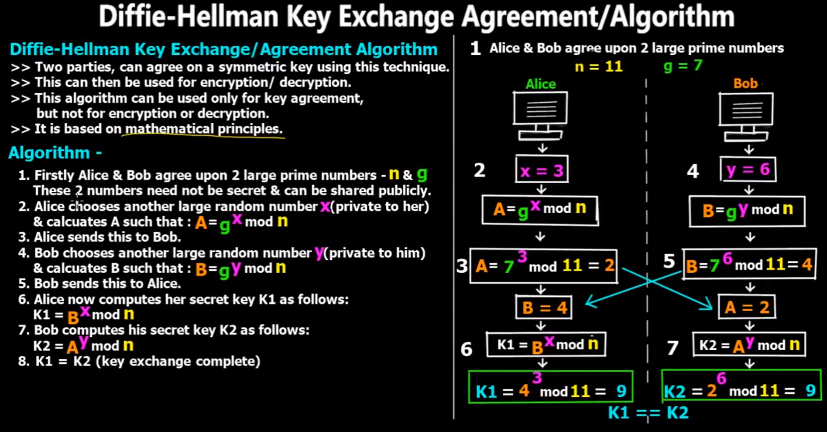

Slide 24
The Diffie-Hellman protocol (informally)
Fix a large prime p (e.g. 600 digits i.e 2K bits)
Fix an integer g in {1, …, p}
Alice
Bob
choose random a in {1,…,p-1}
choose random b in {1,…,p-1}
Bª (mod p) = (g^{b})ª =
k_{AB} = g^{ab} (mod p)
= (gª)^{b} = A^{b} (mod p)
Notes:
“Alice”, A = ga (mod p) ; “Bob”, B = gb (mod p)
600 digits corresponds to 2000 bits (2KB of data)
Martin Hellman and With-Diffie

Slide 25
Security
Eavesdropper sees:
p, g, A=gª (mod p), and B=g^{b} (mod p)
Can she compute g^{ab} (mod p) ??
More generally: define DH_{g}(gª, g^{b}) = g^{ab} (mod p)
How hard is the DH function mod p?
Notes:
Eve can see prime (p) and generator (g)
In the mathematics of the real numbers, the logarithm log_{b} a is a number x such that b^{x} = a, for given numbers a and b. Analogously, in any group G, powers b^{k} can be defined for all integers k, and the discrete logarithm log_{b} a is an integer k such that b^{k} = a.

Slide 26

How hard is the DH function mod p?
Suppose prime p is n bits long.
Best known algorithm (GNFS): run time exp( )
cipher key size modulus size
80 bits 1024 bits
128 bits 3072 bits
256 bits (AES) 15360 bits
As a result: slow transition away from (mod p) to elliptic curves
Elliptic Curve size
160 bits
256 bits
512 bits
Notes:
GNFS → General Number Field Sieve
Problem is difficult but it is not exponential. It is near to cube root of n

Slide 27
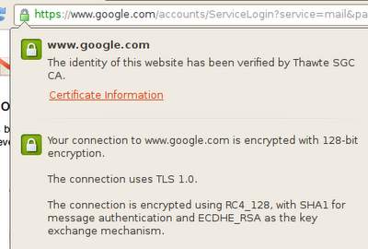
Elliptic curve Diffie-Hellman
What is the difference between ECDHE-RSA and DHE-RSA?
DHE-RSA is (in one sentence) Diffie Hellman signed using RSA keys.
Where DH is used for forward secrecy and RSA guards against MITM, but where do the elliptic curves in ECDHE-RSA are exactly used? What upsides has ECDHE-RSA over DHE-RSA
ECDHE suites use elliptic curve diffie-hellman key exchange, where DHE suites use normal diffie-hellman. This exchange is signed with RSA, in the same way in both cases.
The main advantage of ECDHE is that it is significantly faster than DHE. This blog article talks a bit about the performance of ECDHE vs. DHE in the context of SSL.
Source: https://security.stackexchange.com/questions/14731/what-is-ecdhe-rsa

Slide 28
Insecure against man-in-the-middle
As described, the protocol is insecure against active attacks
Alice
MiTM
Bob
Later we will see that it is not that difficult to enhance the protocol against MiTM attack
Notes:
Insecure against Active Attacks (man-in-the-middle)

Slide 29
Further readings
Merkle Puzzles are Optimal, B. Barak, M. Mahmoody-Ghidary, Crypto ’09
On formal models of key exchange (sections 7-9) V. Shoup, 1999

Slide 30
Acknowledgements
Material in this lecture are taken from the slides prepared by:
Prof. Dan Boneh (Standford)

